Slide 1

利用Python提升效率
宋传胜
chuansheng.song@langtaojin.com

Slide 2



Slide 3
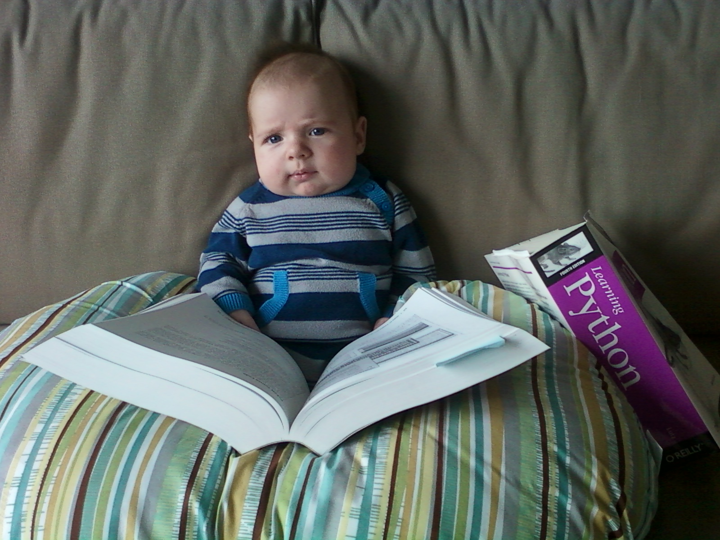
Learning Python is Easy!

Slide 4
安装
python 2.7
安装setuptools http://pypi.python.org/pypi/setuptools
pip
搜索python的库 http://pypi.python.org/pypi/

Slide 5
工欲善其事，必先利其器
Eclipse + pydev
Wing IDE
Vim – 打造python ide
Textmate/Vico @ mac
ipython / pyrepl
Dreampie @ windows

Slide 6
代码风格
总是用4个空格缩进，不要用tab
不要import *
不要empty try, try … catch: pass

Slide 7
Builtin
dir – dir(__builtin__)
help – help(str.split)
range – range(1, 10, 2)
enumerate – enumerate(range(1, 10))
hasattr/getattr
len – len(range(1,10))
bin/oct/hex
chr/ord – chr(97) ord(‘a’)

Slide 8
Builtin
print – print "test\r",; print "ab”
sorted – sorted([1,9,2,8])
repr
round – round(9.1111, 2)
type

Slide 9
基本数据结构
s = “str”
u = u”中文”
m = {‘a’:1, 2:’test’}
a = [1,2,3]
t = (1,2,3)
s = set([1,2,3])

Slide 10
collections
Defaultdict
  if d.has_key(key): d[key].append(v); else: d[key]=[v]
  d.setdefault(key, []).append(v)
namedtuple
  p = namedtuple('Point', 'x y z’); p(0, 0, 0)

Slide 11
Generator
[x*2 for x in range(1, 10)]
[x for x in range(1, 10) if x > 2]
def range(from, to):
  i = from
  while i < to:
  yield i
  i+=1

Slide 12
Decorator
def require_int (func):
def wrapper (arg):
assert isinstance(arg, int)
return func(arg)
return wrapper
@require_int
def p1 (arg):
print arg
➔ 等价于 require_int(p1)(arg)

Slide 13
String
encoding: utf-8
u“中文”.encode(‘gbk’)
“中文”.decode(‘utf8’)
“test”.encode(‘hex’)
cgi.escape("http://a.com/?test=12&o=2")
  'http%3A//a.com/'
urllib.quote("http://a.com/?a=1")
  'http%3A//a.com/%3Fa%3D1'

Slide 14
re
r = re.compile(r’\b([^ ]+)\b’, re.M|re.S)
m = r.search(s); m.group(1) 查找
r.subn(r’ \g<1> ’, src) 替换

Slide 15
ip
struct.unpack('>I', socket.inet_aton(ipstr))[0]
socket.inet_ntoa(struct.pack(">I", 3232235521))

Slide 16
time/datetime
time.time()
datetime.datetime.fromtimestamp(timestamp)
time.mktime(datetimeobj)
datetime.datetime.strptime('20120102 12:11:22', '%Y%m%d %H:%M:%S')

Slide 17
文件
遍历文件内容
  for line in open(“file”, “r”)
字符串转换为文件流接口
  cStringIO.StringIO(string)
shutil.move/copy/stat/rmtree
os.listdir / glob.glob
os.walk – 遍历所有子目录和文件
stat

Slide 18
doctest
doctest_demo.py

Slide 19
网络相关
urllib2
urlparse
cgi

Slide 20
标准库
pprint – 美化打印
bisect – 二分查找
headq – 优先级队列
array – 数组
math
pickle/cPickle – 序列化
zlib/gzip/bz2 – 压缩
csv – 读写csv

Slide 21
标准库
md5/sha -- md5.md5('a').hexdigest()
colorsys – rgb-hsv-hls转换
unittest
itertools
functools
python –m SimpleHTTPServer 8000

Slide 22
调试
import pdb; pdb.set_trace()
traceback – traceback.print_exc/format_exc

Slide 23
profiling
python -m cProfile your.py
hotshot

Slide 24
第三方库

Slide 25
python-gflags
import gflags
gflags.DEFINE_integer('lport', 3306, "local port")
FLAGS = gflags.FLAGS
FLAGS.lport
argv = FLAGS(sys.argv)[1:]

Slide 26
其他第三方库
PIL – 图片处理，Image.thumbnail
sqlalchemy – sql ORM
simplejson
protobuf
lxml
jinja2
redis
libmemcached

Slide 27
Web框架
django
web.py
tornado

Slide 28
PYGAGA
git clone ssh://user@review.jcndev.com:29418/pygaga
python setup.py install

Slide 29
pygaga -- 日志
log_demo.py
python log_demo.py --stderr --verbose info --color --use_logfile
cat timedlog/log_demo.py.log | tailc
python log_demo.py --stderr --verbose info --color --pbverbose warning --pbcate test --use_paperboy
http://bi.jcndev.com/dev/paperboy/logs

Slide 30
pygaga -- lock
File lock
Zookeeper lock
Redis lock
lock_demo.py

Slide 31
pygaga -- cache
from pygaga.helpers.cache import lru_cache
@lru_cache(maxsize=1000, maxsec=10)
def f(x, y):
return x+y

Slide 32
pygaga -- mysql
db_dmeo.py

Slide 33
pygaga – url相关
pygaga.helpers.urlutils.get_qs
pygaga.helpers.urlutils.get_url_arg
pygaga.helpers.urlutils.download – 支持cookie和dns缓存的下载

Slide 34
pygaga -- 解析html
pygaga.helpers.utils.parse_html
  def parse_html(html, encoding='utf8'):
  try:
  html_obj = etree.XML(html.encode(encoding))
  except:
  try:
  html_obj = soupparser.fromstring(html)
  except:
  html_obj = etree.HTML(html.encode(encoding))
  return html_obj

Slide 35
pygaga – 单机多进程
pygaga.helpers.mapreduce_multiprocessing.SimpleMapReduce

Slide 36
pygaga – 流控
pygaga.helpers.ratelimit.chunk – 分片
pygaga.helpers.ratelimit.droplimit – 丢弃
pygaga.helpers.ratelimit.waitlimit – 排队
场景
  [chunk for chunk in waitlimit(calllimit, 60.0, chunks(items, batch_size))]

Slide 37
pygaga – 中文相关
pygaga.helpers.pinyin.hanzi2pinyin
pygaga.helpers.mmseg.mmseg2
pygaga.helpers.cmmseg_utils.cmmseg2
pygaga.helpers.i18n.smartdecode

Slide 38
pygaga – 工具函数
pygaga.helpers.utils.java_string_hashcode
pygaga.helpers.utils.make_dirs_for_file
pygaga.helpers.rc4decrypt.rc4decrypt
pygaga.helpers.thumb.pil_thumb
pygaga.helpers.gmail.gmail.send
pygaga.helpers.dateutils.dates

Slide 39
pygaga – 命令行小工具
echosleep
py_baby_sitter – 如果命令返回不为0就发邮件
sshforward --lport 3306 --rport 3306 --rhost 192.168.10.42 --pidfile /tmp/1.pid --shost log.j.cn --daemon --use_logfile
ip2.py (需要安装pytst)
  echo -e "123.125.114.144\n65.55.58.201"|ip2.py|iconv -f gbk -t utf8

